Slide 1


FACIAL GESTURES BASED HUMAN MACHINES INTERACTION FOR PHYSICALLY DISABLED PEOPLES
TEAM MEMBERS:
DINESH KUMAR B.J(211616205031)
ANANTHKUMAR R(211616205009)
AKSHAY D(211616205007)
TEAM SUPERVISOR:
SREE SUBHA S(AP/IT)
BATCH NO: 2020ITA13
DOMAIN: COMPUTER VISION

Slide 2
ABSTRACT
As there is great advancement in the technology in recent years, there has been much improvement in various fields of computing such as Human Computer Interaction (HCI), Computer Vision. Input to the computers has sensed information about physical properties of user, places, or things. For example, computer mouse and keyboard operates by motion imparted by user’s hand. All these techniques may not be suitable to physically disabled people. A way to create an application which replaces the input devices such as mouse and keyboard by using face of the user is proposed. This project introduces how head motion of user can be used to control the mouse cursor and how gaze tracking can be used to control the keyboard. A face detecting system precisely records the motion parameters from video at real-time using a typical webcam. While the speed decreases when controlling the virtual keyboard and mouse, the system’s performance remains functioning for severely disabled people who have their gaze and head movements as one of their only means of communication.

Slide 3
PROBLEM STATEMENT
What is the need for software application for eye tracking keyboard and mouse cursor control?
To avoid the eye damage caused by hardware devices.
To enable effective communication for disabled people with computer using head motions.
Tracking the gaze in the traditional keyboard layout is difficult.

Slide 4
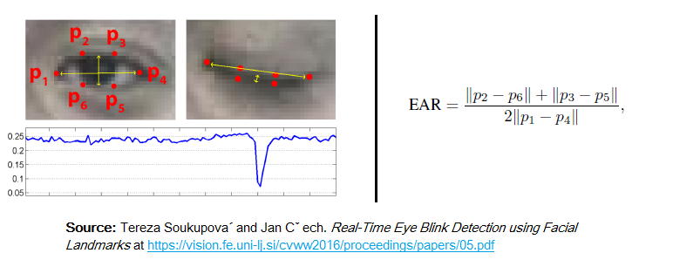
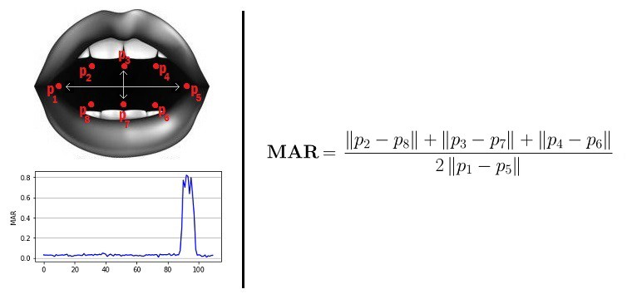
BASIC CONCEPTS
Eye-Aspect Ratio (EAR) :
Eye-Aspect-Ratio is the simplest and the most elegant feature that takes good advantage of the facial landmarks.
EAR helps us in detecting blinks and winks etc.
You can see that the EAR value drops whenever the eye closes.
Mouth-Aspect Ratio (MAR):
Similar to EAR, MAR value goes up when the mouth opens.
Dwell-time method:
The desired key is selected when the focus time has reached the threshold limit.
The focus time will start new count when the previous count has reached.

Slide 5
ISSUES & CHALLENGES
Image processing is difficult when there are multiple faces in the room.
Optimal lighting conditions are required.
The system may detect a person talking as a sign to deactivate the system.
Identifying the eye in the frame becomes difficult if the person is wearing glasses.
The person needs to be conscious of opening and closing the mouth in order to avoid undesired activities.

Slide 6
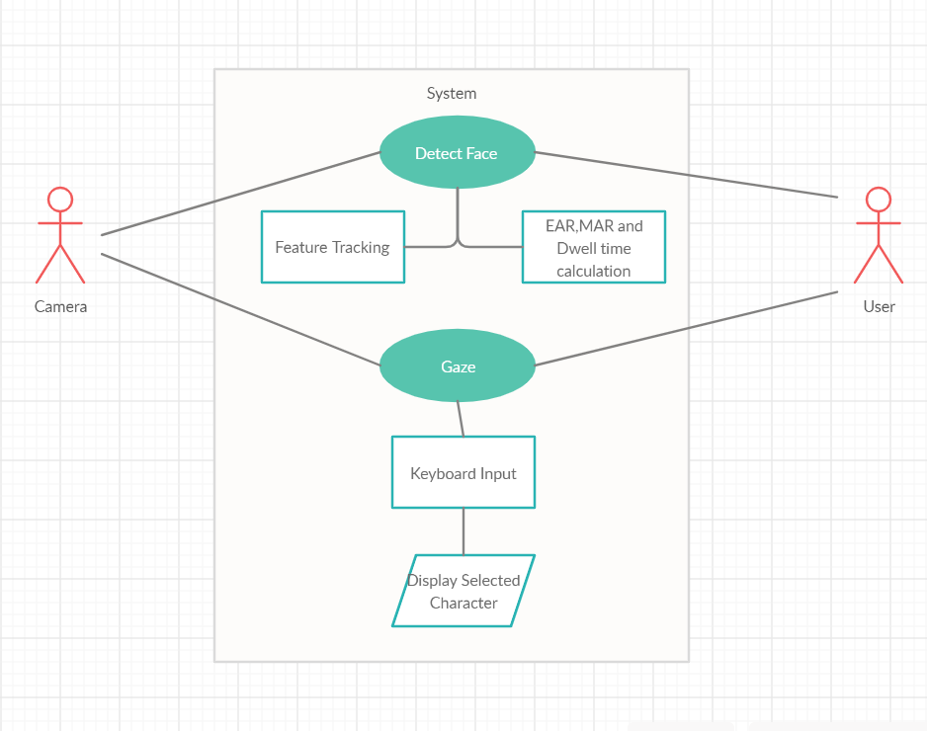
UML DIAGRAMS USE CASE DIAGRAM FOR VIRTUAL KEYBOARD LAYOUT

Slide 7
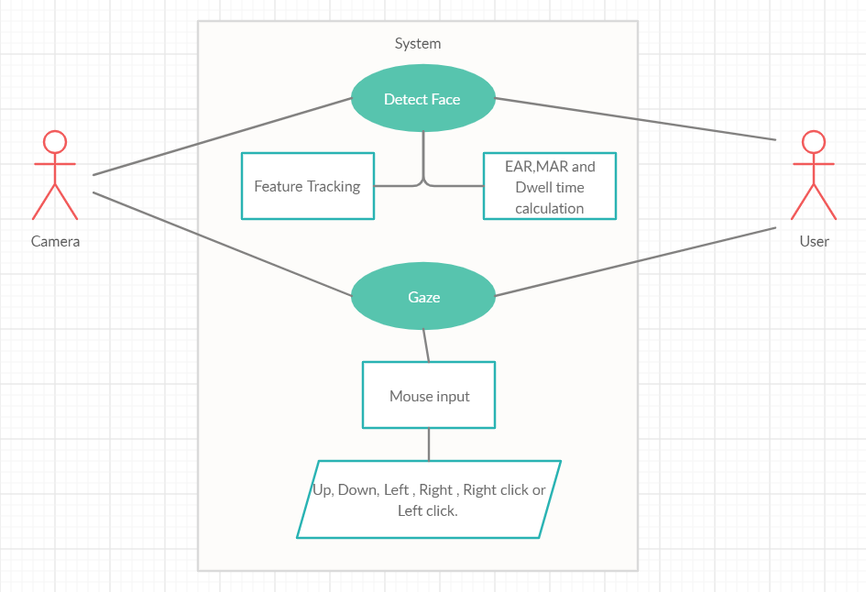
USE CASE DIAGRAM FOR VIRTUAL MOUSE CURSOR

Slide 8
PROPOSED WORK
A system to implement the mouse cursor movements and the character selections of keyboard using the head movements and gaze tracking.
Activation/Deactivation of the mouse movements using Mouth-Aspect Ratio (MAR) is introduced.
Scroll movements of the mouse is introduced in this model.
Since the traditional keyboard layout is inefficient, a tree selection method is used.
In addition to alphabets, numbers,commonly used sentences and shortcuts to help disabled people in times of emergency is introduced.

Slide 9
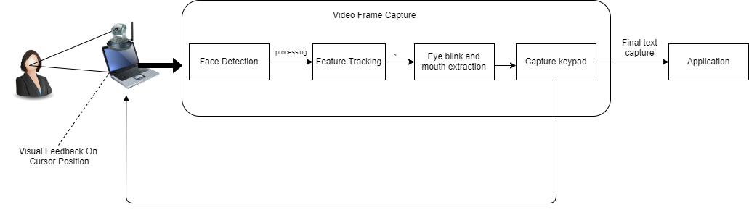
ARCHITECTURE DIAGRAM
Figure 1 Architecture Diagram of Eye Tracking Keyboard

Slide 10
MODULES

Slide 11
DETAILED MODULE DESCRIPTION
MOUSE MODULE
Step 1: At first, a camera is set up that monitors a stream for faces (OpenCV library is used for rapid and accurate image processing).
Each pixel in the given image is classified as a skin pixel or a non-skin pixel.
The different skin regions in the skin-detected image are identified by using connectivity analysis to whether each region identified is a face or not.
Step 2: If a face is detected, the landmarks of facial features like eyes and mouth are mapped on the face using dlib library.
Facial Landmark- It is a inbuilt HOG SVM classifier used to determine the position of 68(x, y) coordinates that map to facial structures on the face.
The indexes of the 68 coordinates are landmarked.
Step 3: After locating the eye and mouth landmarks, the eye aspect ratio and mouth aspect ratio is calculated.
Step 4: Further if the eye aspect ratio and mouth aspect ratio varies abruptly from the pre-defined threshold value for a specific amount of time then the corresponding event is performed.

Slide 12
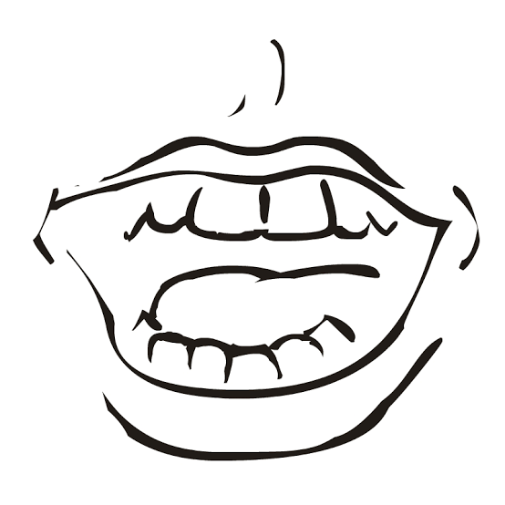
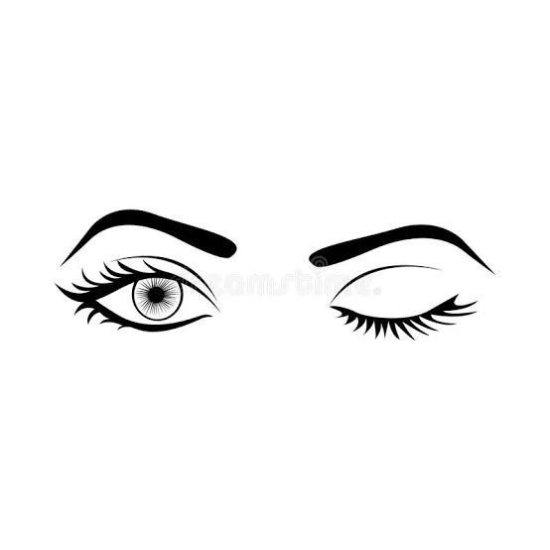
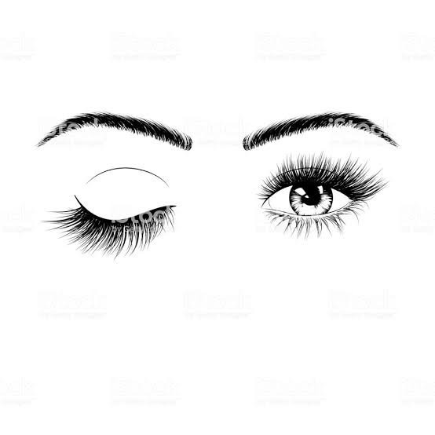
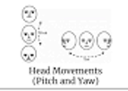
MOUSE MODULE
Action | Functions
 | Activate/Deactivate Mouth Control
 | Right Click
 | Left Click
 | Cursor Movement
Figure 2 Mouse movements

Slide 13
DETAILED MODULE DESCRIPTION
KEYBOARD MODULE
Once the face is detected, the landmarks of facial features like eyes are mapped on the face using dlib functions.
The indexes of the 68 coordinates are landmarked.
Calibration is done effectively.
The GUI of the virtual keyboard is composed of two main components: the center of the screen where the text is displayed, and the edges of the screen where the character sets are displayed.
It is based on a tree selection method.
In the first level, the 5 sections are scanned by using dwell-time method.
In the second level, 5 sections are dedicated to the selection of letters “ABCDE, FGHIJ, KLMNO, PQRST,UVWXYZ”.
For instance, if the user selects the first command “ABCDE” then the sections s1, s2, s3, s4 and s5 become “A,” “B,” “C,” “D,” “E”.

Slide 14

KEYBOARD MODULE
A B C D E | G H I J K | L M N O P
W Y Z SP DEL |  | Other numbers shortcut
gazing
transformation
A | B | C
D |  | E
Figure 3 Virtual Keyboard

Slide 15
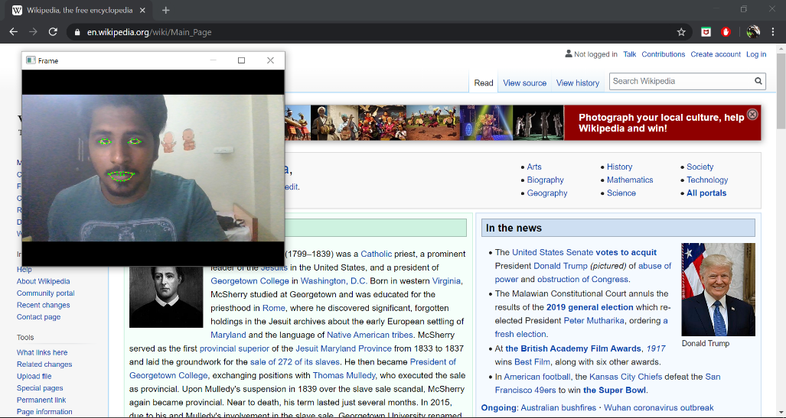
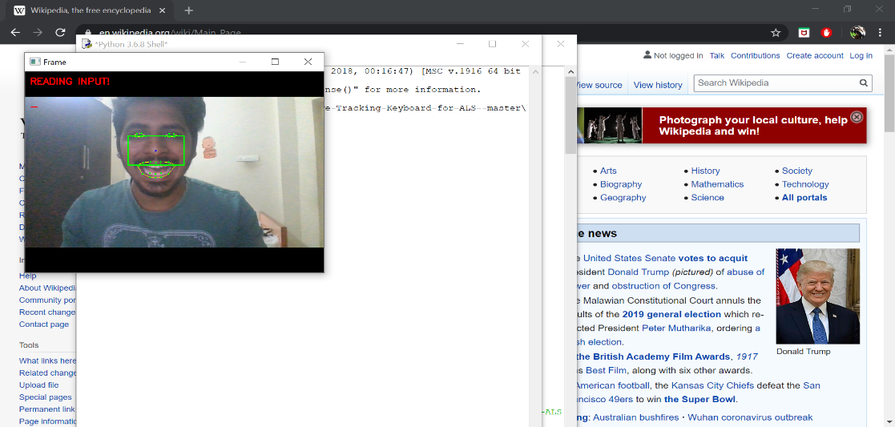
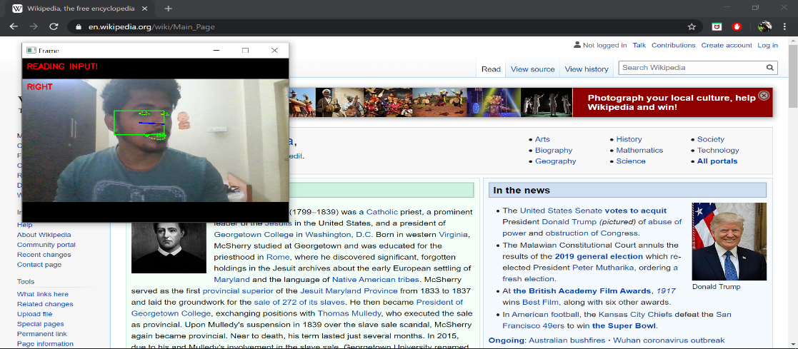

IMPLEMENTATION SCREENSHOTS
MOUSE MODULE
FEATURE EXTRACTION
ACTIVATION/DEACTIVATION
RIGHT MOVEMENT
LEFT MOVEMENT

Slide 16
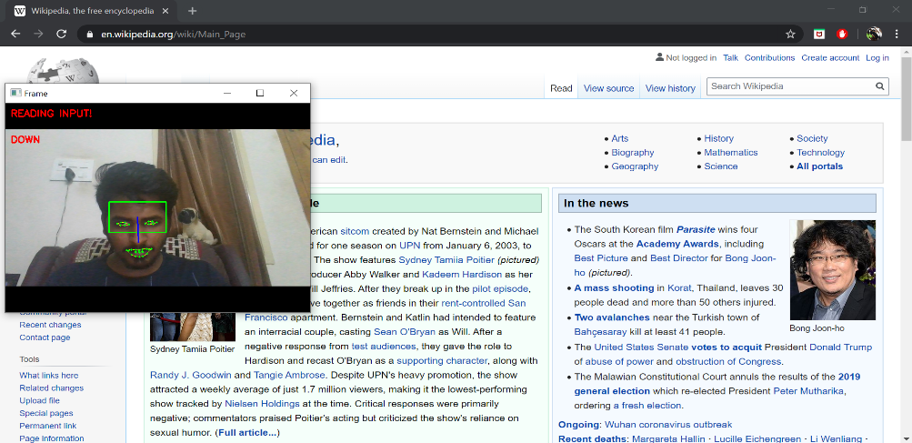
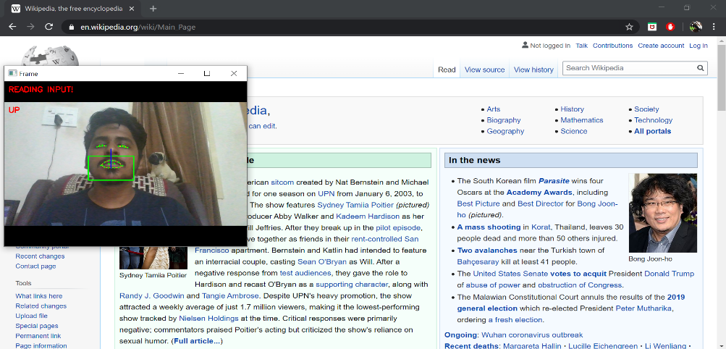
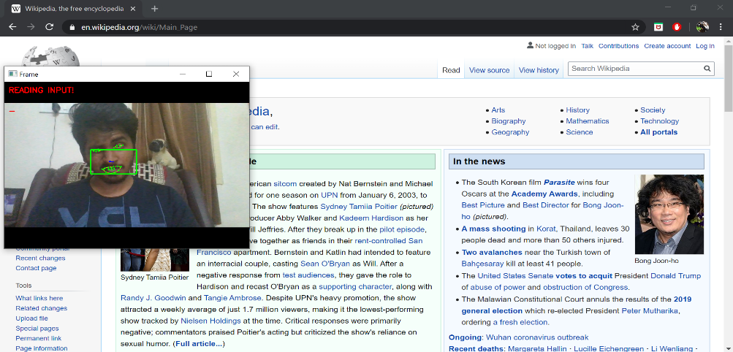
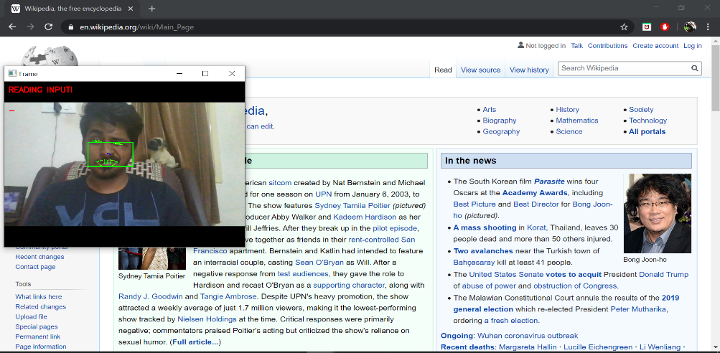
IMPLEMENTATION SCREENSHOTS
MOUSE MODULE
UPWARD MOVEMENT
DOWNWARD MOVEMENT
RIGHT WINK
LEFT WINK

Slide 17
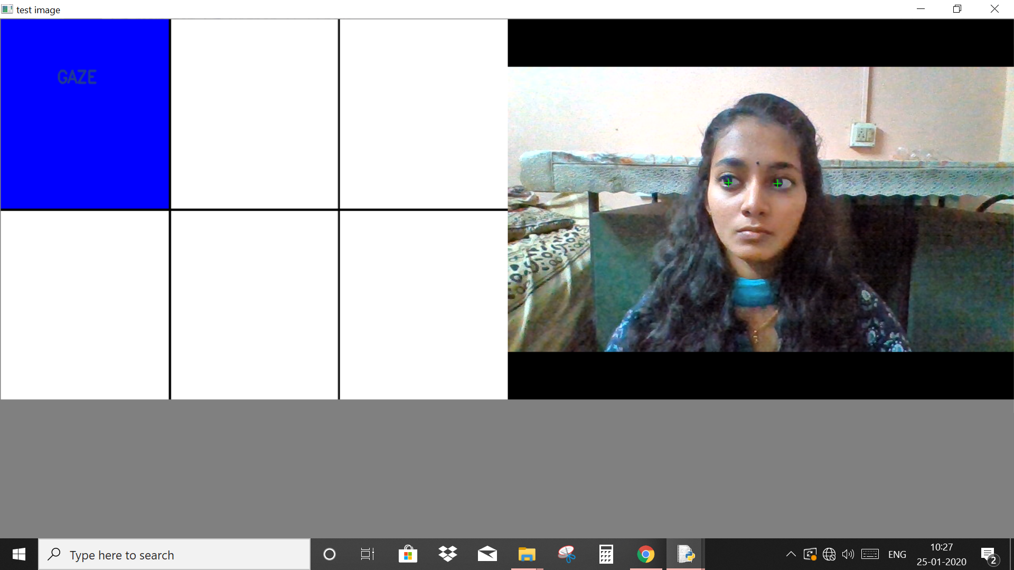
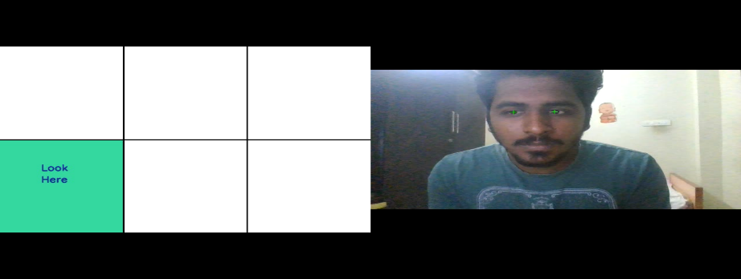
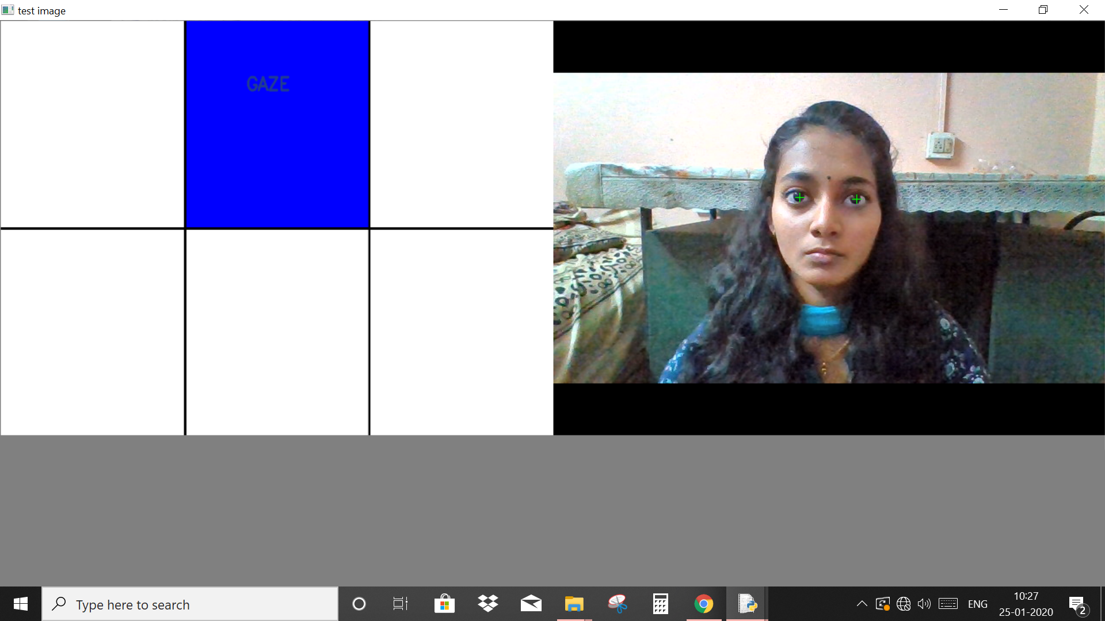
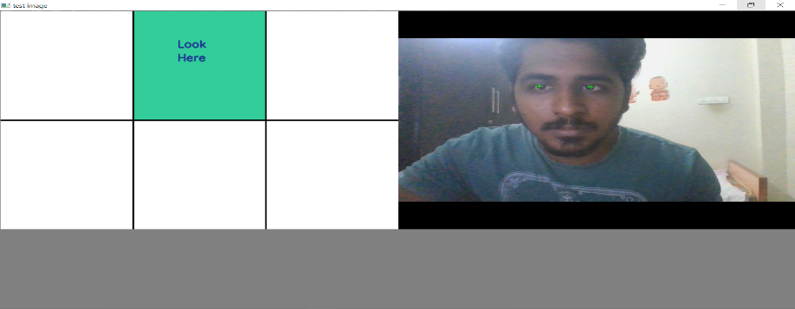
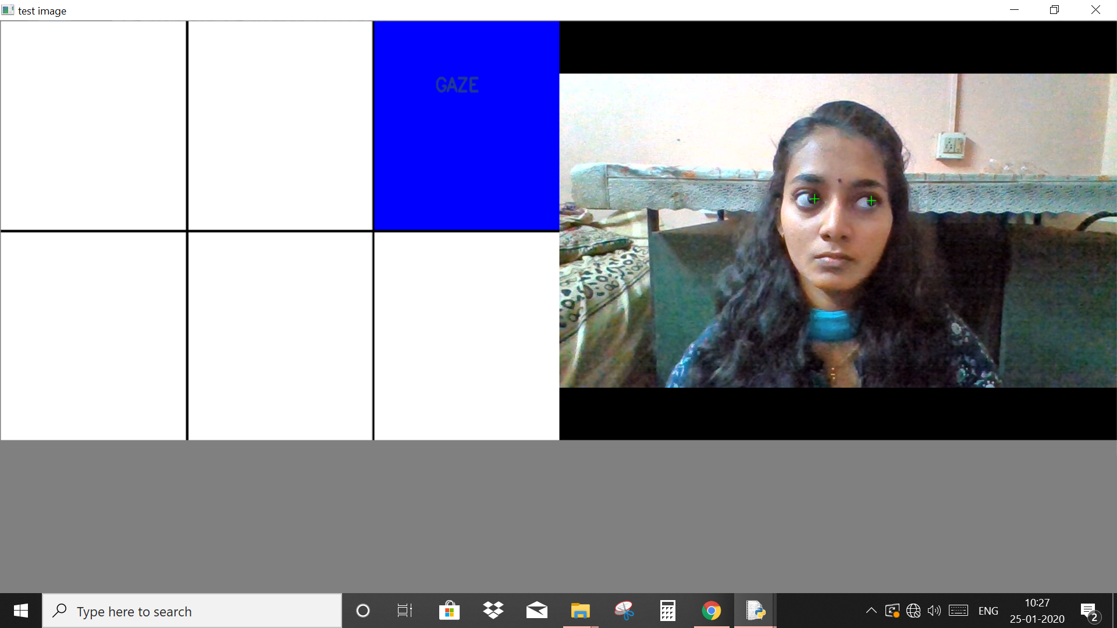
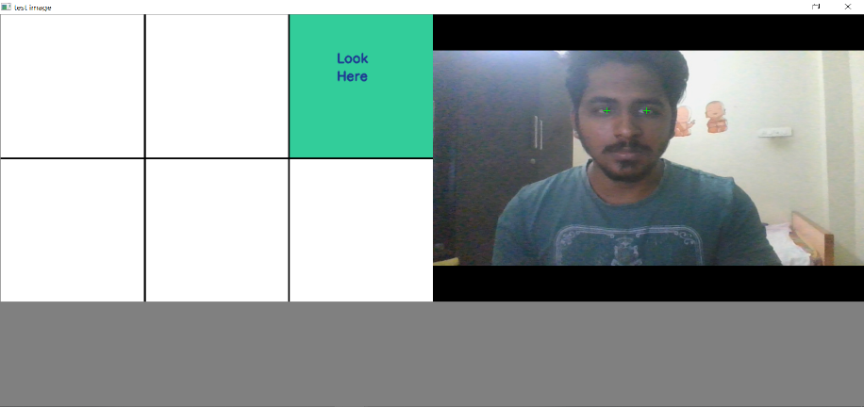
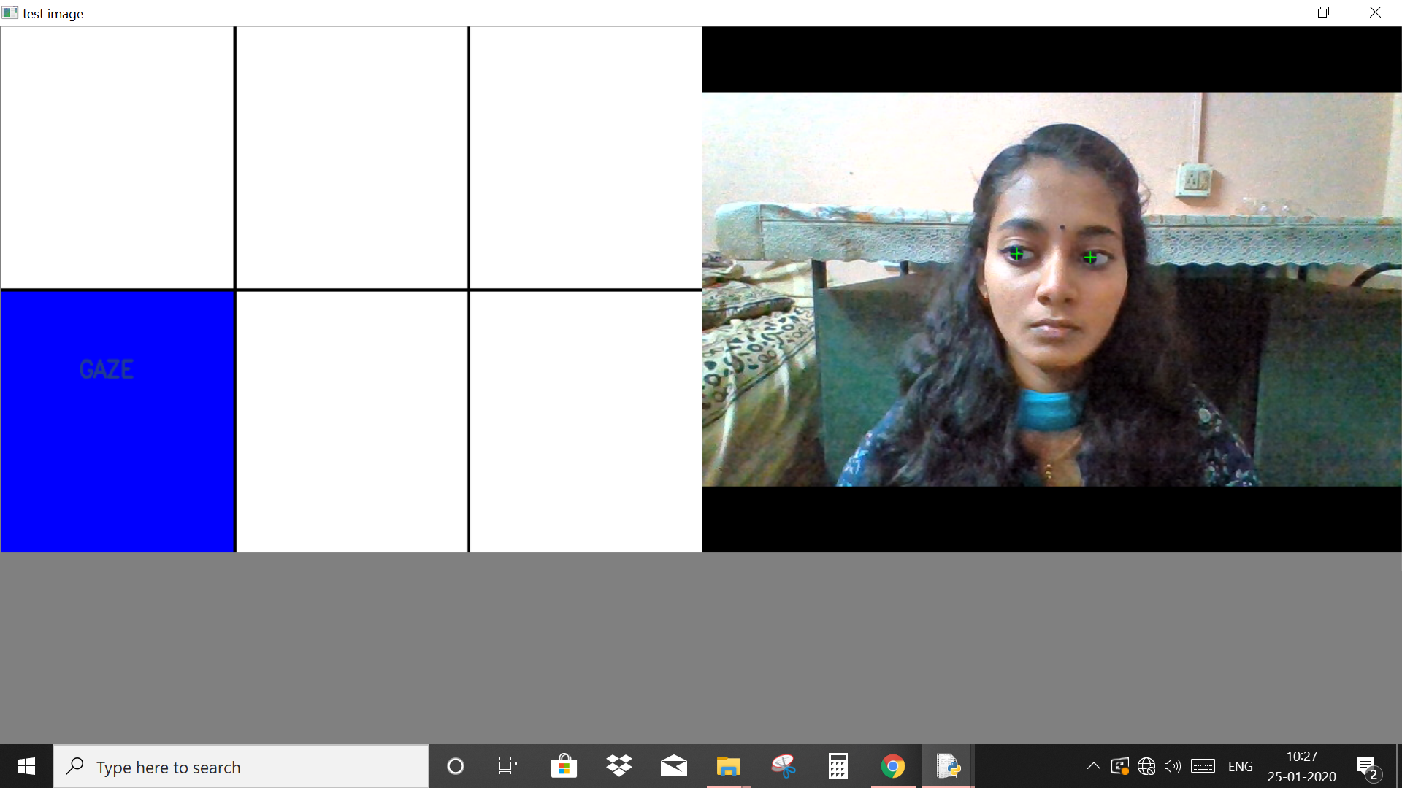
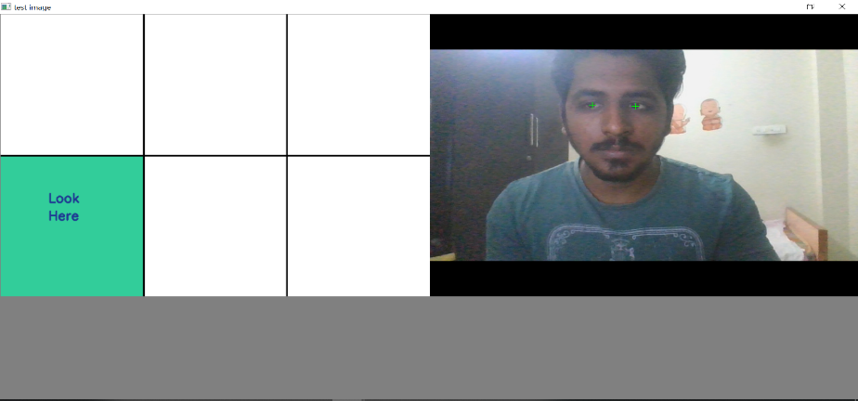
IMPLEMENTATION SCREENSHOTS
KEYBOARD MODULE
UP LEFT
UP CENTRE
UP RIGHT
DOWN LEFT

Slide 18
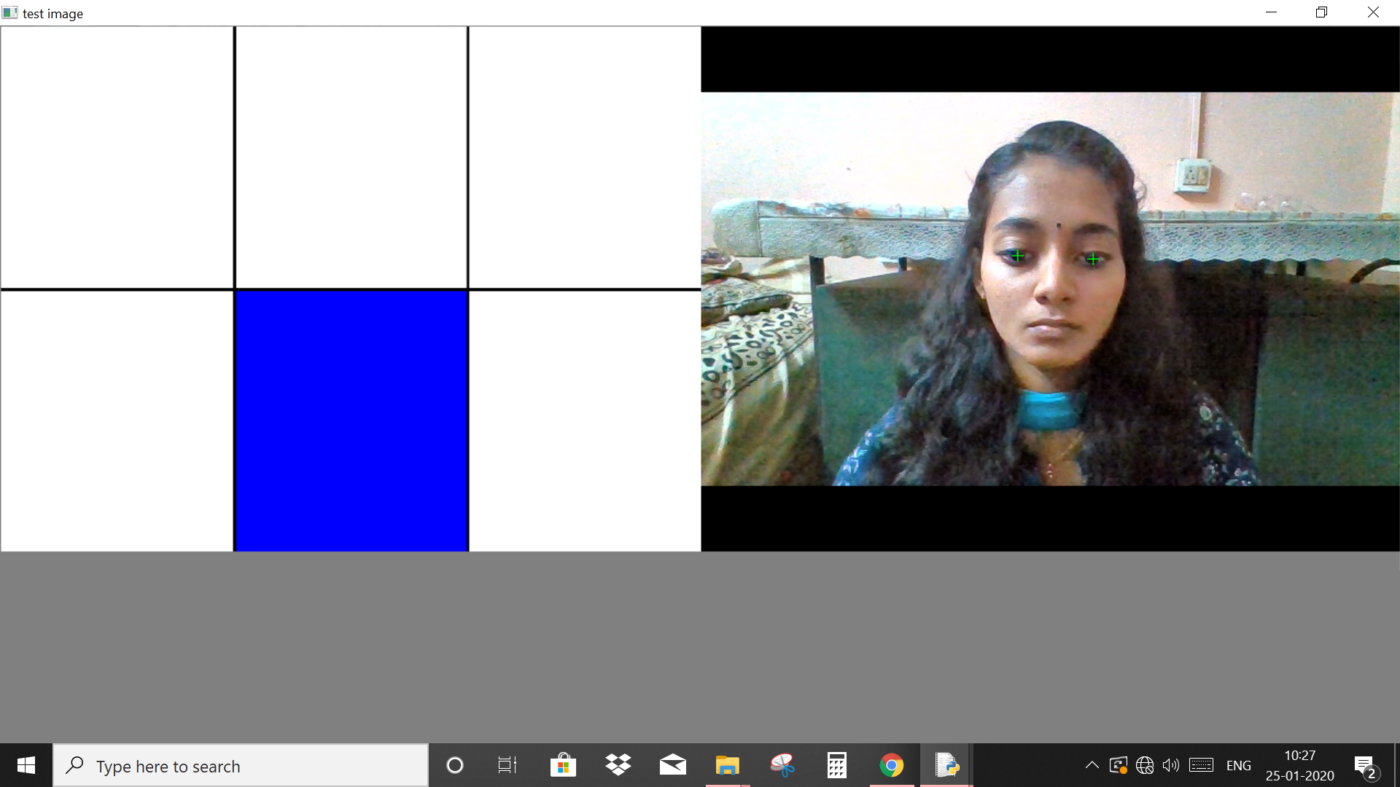
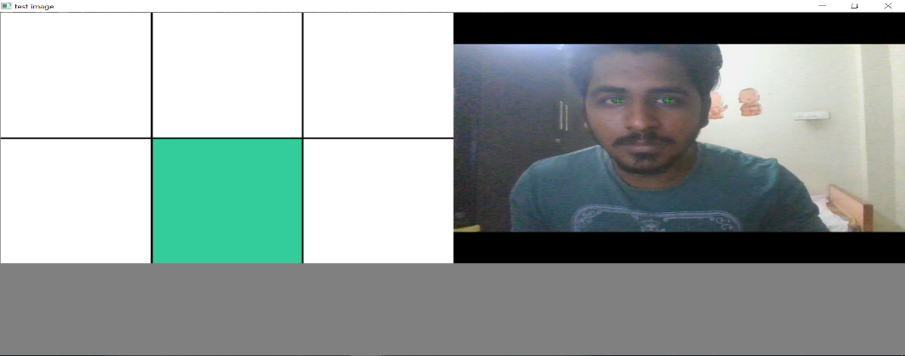
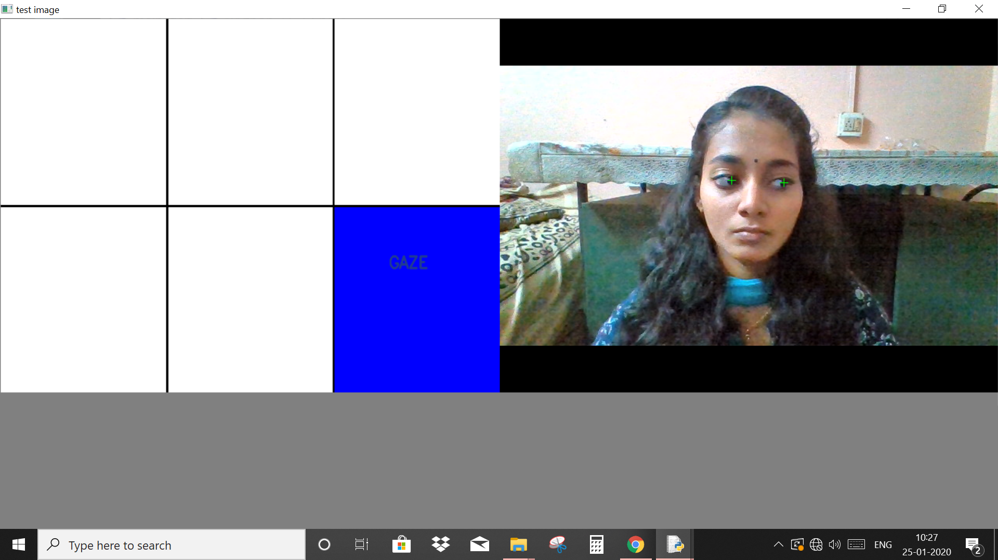
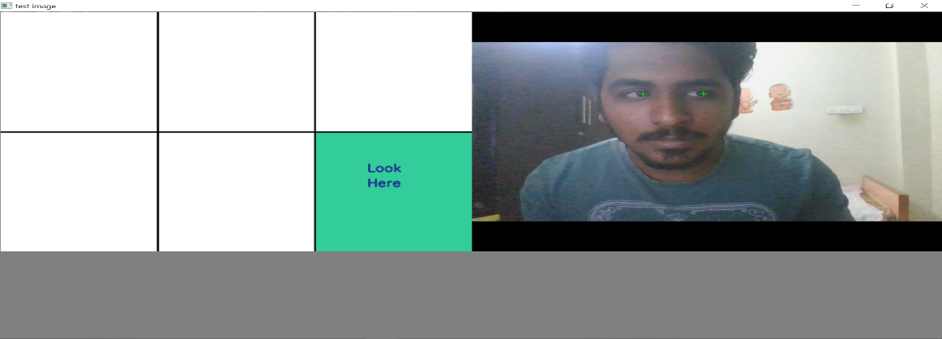
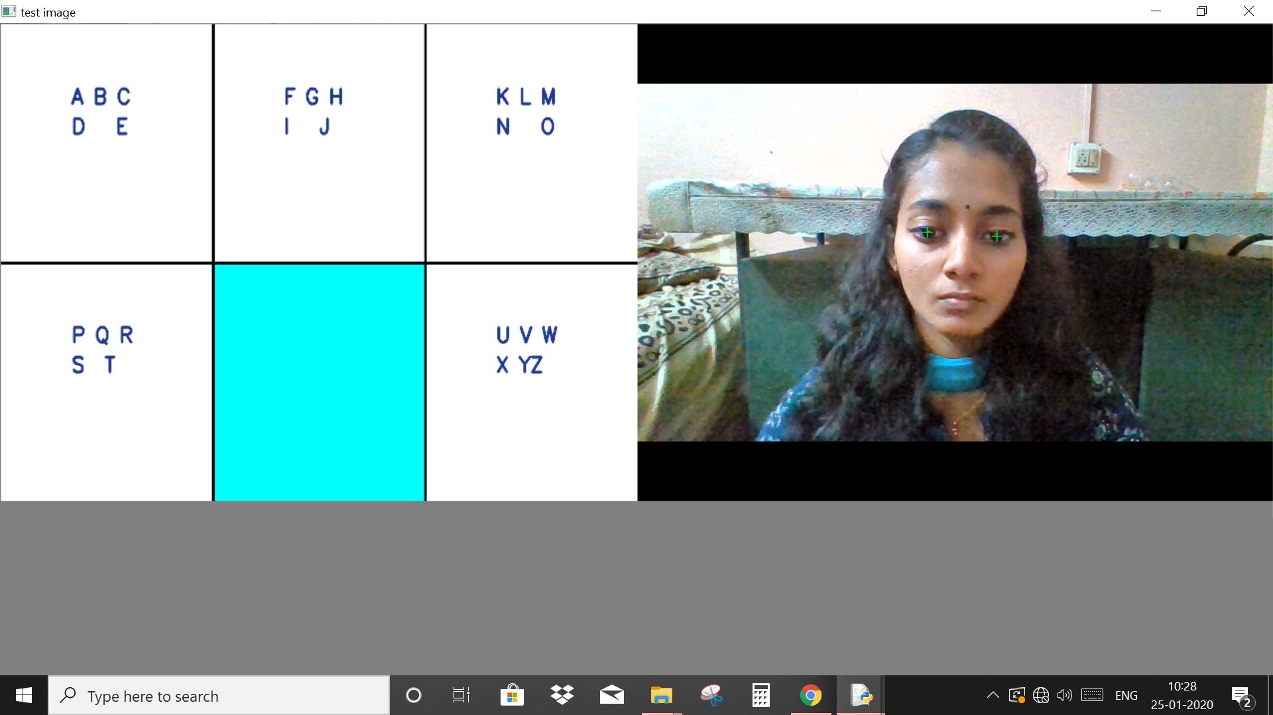
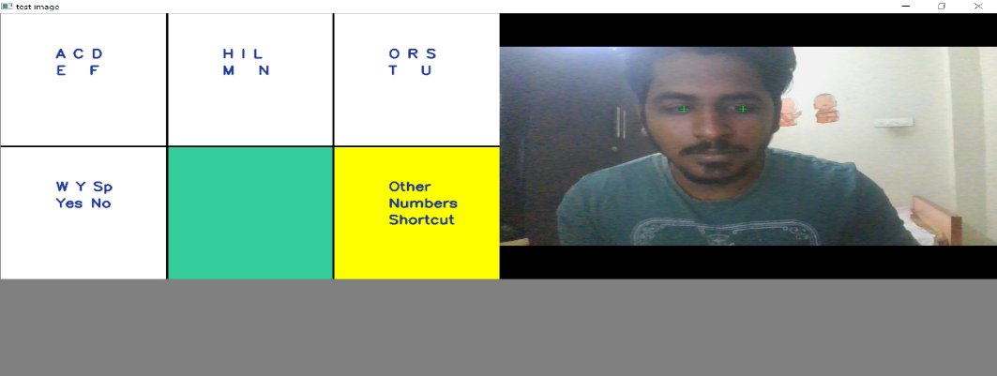
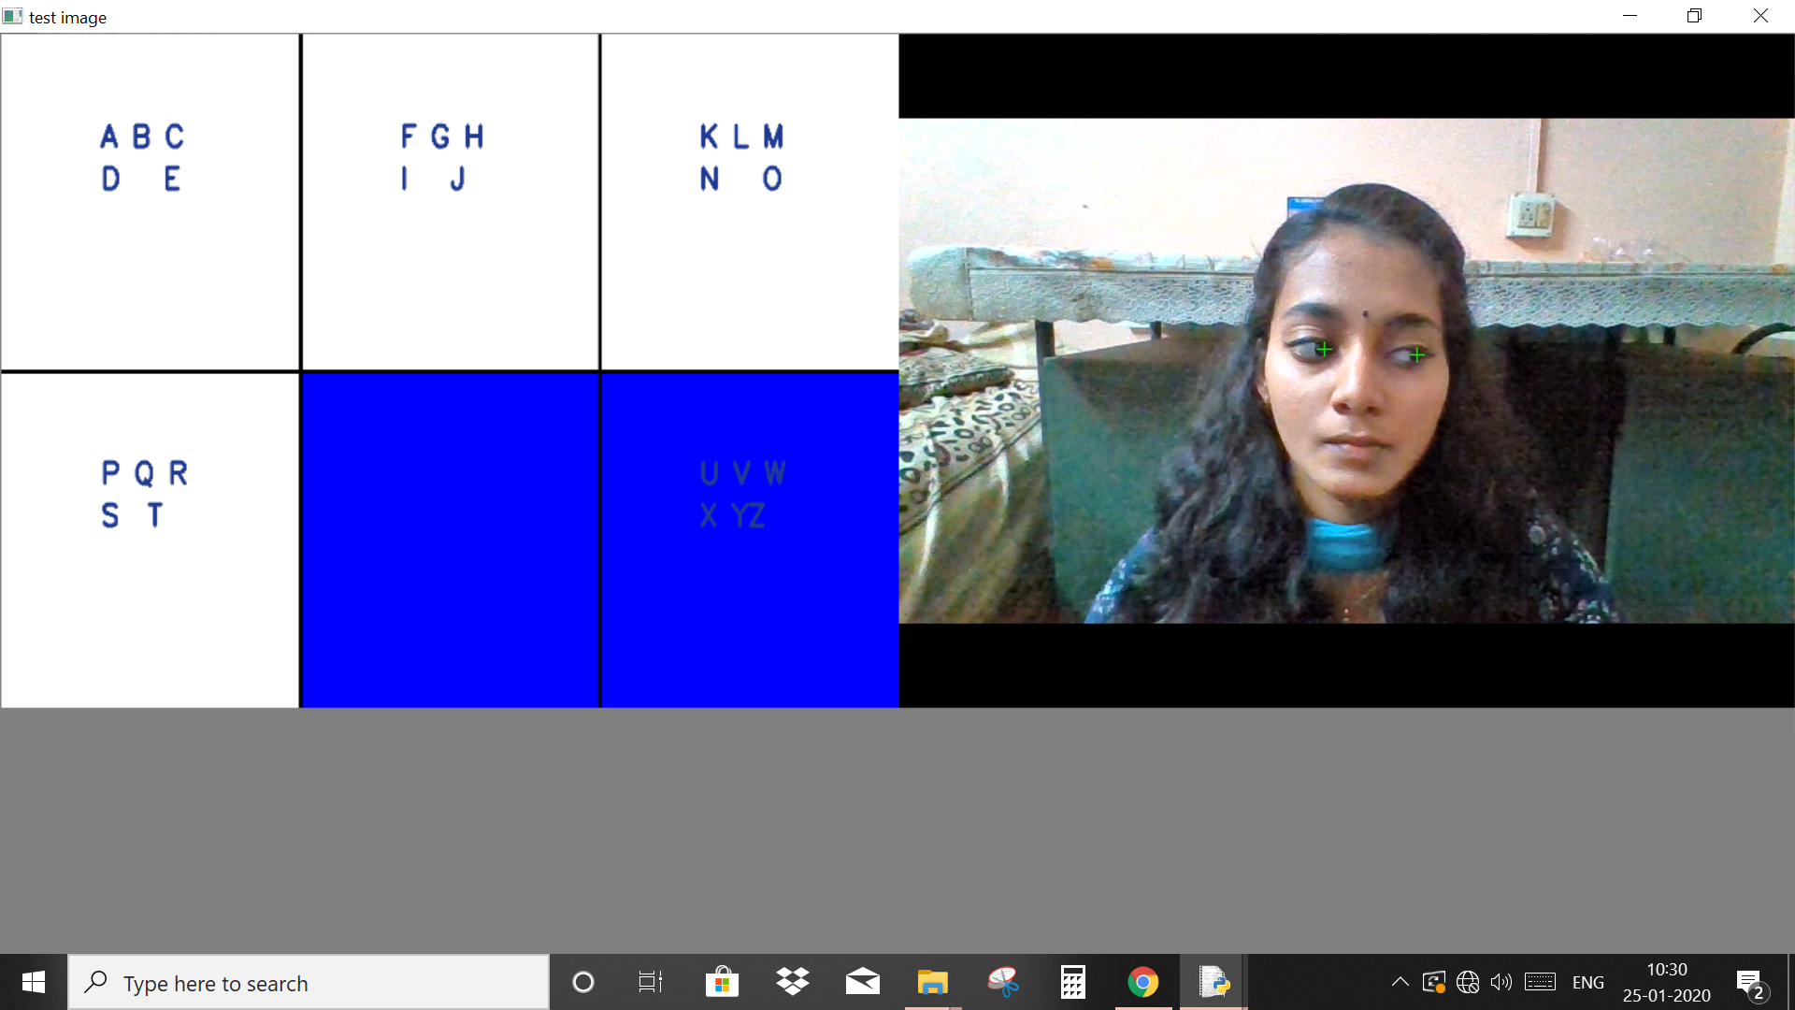

IMPLEMENTATION SCREENSHOTS
KEYBOARD MODULE
DOWN CENTRE
DOWN RIGHT
SECOND TREE LEVEL
CHARACTER SET SELECTION

Slide 19
SYSTEM REQUIREMENTS & TOOLS
Hardware Requirements
Processor: Intel Core i7 8th gen
Hard Disk Drive: 1TB
Ram: 16GB
GPU: Nvidia Geforce GTX 1050 Ti
Software Requirements
Operating System : Windows 10
Programming Language: Python 3.7
Tools: Numpy, dlib, pyautogui, imutils, OpenCV, pandas, scikit-learn

Slide 20
CONCLUSION
The suggested model provides an alternative solution to external input devices. This model uses face/head motion to control the movement of mouse cursor such as right eye wink for right click, left eye wink for left click, head rotation for mouse movement and gaze tracking for using a virtual keyboard. The system provides an alternative solution for future computing devices, such as PDA, Tablet, Laptops, and GPS. It inspires various PC based application like gaming, entertainment, robotics, etc. The suggested system improves the living conditions of disabled people since the system works efficiently even under sub-optimal lighting and with the use of spectacles.

Slide 21
REFERENCES
1. Y. K. Meena, H. Cecotti, K. Wong-Lin, A. Dutta and G. Prasad (2018) , "Towards Optimization of Gaze-Controlled Human–Computer Interaction: Application to Hindi Virtual Keyboard for Stroke Patients," in IEEE Transactions on Neural Systems and Rehabilitation Engineering, vol. 26, no. 4, pp. 911-922,
2. H. Cecotti, "A Multimodal Gaze-Controlled Virtual Keyboard," in IEEE Transactions on Human-Machine Systems, vol. 46, no. 4, pp. 601-606, Aug. 2016.
3. H. Cecotti, Y. K. Meena and G. Prasad, "A multimodal virtual keyboard using eye-tracking and hand gesture detection," 2018 40th Annual International Conference of the IEEE Engineering in Medicine and Biology Society (EMBC) 2018, pp. 3330-3333.
4. Sara Bilal, Mohamad Hassrol Bin Mat, and Rasheed Nassr, “Design a Real-Time Eye Tracker”, Proceedings of the 2018 the 2nd International Conference on Video and Image Processing, 2018 pp. 187–191.
5. H. Cecotti, Y. K. Meena, B. Bhushan, A. Dutta, G. Prasad, "A multiscript gaze-based assistive virtual keyboard", Engineering in Medicine and Biology Society (EMBC) 2019 41st Annual International Conference of the IEEE, pp. 1306-1309, 2019.

Slide 22
REFERENCES
6. Josephine Sullivan and Vahid Kazemi (2014) “One millisecond face alignment with an ensemble of regression trees” Vol. 7 No. 1 pp. 1-8.
7. Aniket Kudale, Leena Deshpande, Rahul Thakare, Vaibhav Laddha (2012) “Mouse Navigation Control Using Head Motion” Vol. 3 No. 3 pp. 1-4.
8. M. Nasor, K. K. M. Rahman, M. M. Zubair, H. Ansari and F. Mohamed, "Eye-controlled mouse cursor for physically disabled individual," 2018 Advances in Science and Engineering Technology International Conferences (ASET) 2018, pp. 1-4.
9. Ashlesha Singh, Chandrakant Chandewar and Pranav Pattarkine (2018)“Driver Drowsiness Alert System with Effective Feature Extraction” Vol. 5, No.2, pp. 26-31.
10. A. Geetha and M. Mangaiyakarasi (2014) “ Cursor Control System Using Facial Expressions For Human-Computer Interaction” Vol. 8 No. 1 pp. 1-5.

